Slide 1
Impact of Interest Rates on Recessions, Inflation, Unemployment and the Global Economy.
Armann Andaya, Justin Dean, Michelle Owino, Riley Unverferth, Kenan White

Slide 2
Context
Recently, the Federal Reserve, the US central bank has been increasing the interest rates to stabilize the economy. Since March of 2022, the rate change (bps) has been increased 8 times.
The Fed was created to help the United States economy run smoothly by monitoring several economic indicators, such as unemployment, consumer prices, and gross domestic product (GDP). The increasing rates are affecting all of us. Rate hikes generally mean higher credit card rates, higher interest on car and business loans, and even mortgages.
Our goal for this project is to analyze how interest rate hikes and drops impact the economy.

Slide 3
Questions:
Do interest rate hikes cause recessions?
Does the federal interest rate impact inflation?
What effect does increase/decrease of interest rates have on unemployment rate?
Based on the current trajectory, is another recession coming? If so, when?
Does an increase in interest rates in the United States affect the global economy?

Slide 4
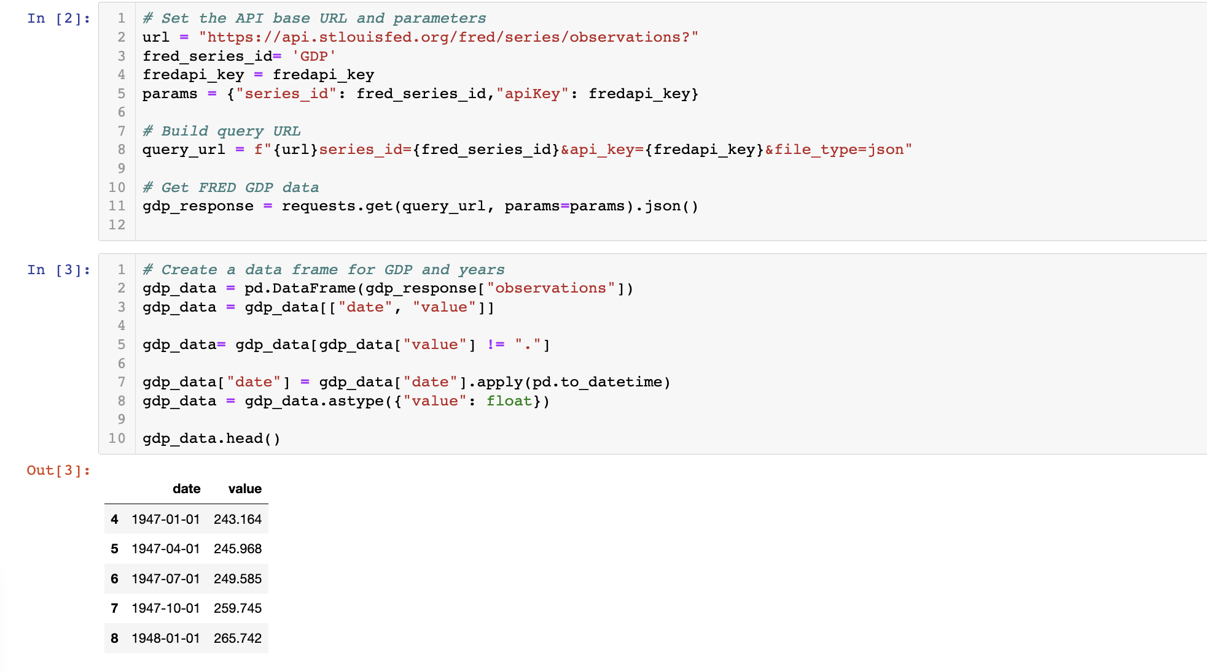
DATA
For this analysis we used FRED to extract data. Data was from 1940s to 2022.
FRED is short for Federal Reserve Economic Data. It’s an online database consisting of hundreds of thousands of economic data time series from scores of national, international, public, and private sources database.
We performed an API call to extract the data.

Slide 5
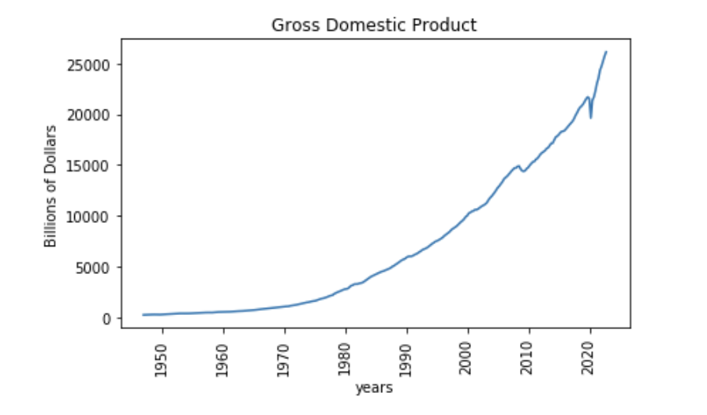
Gross domestic product (gdp)

Slide 6
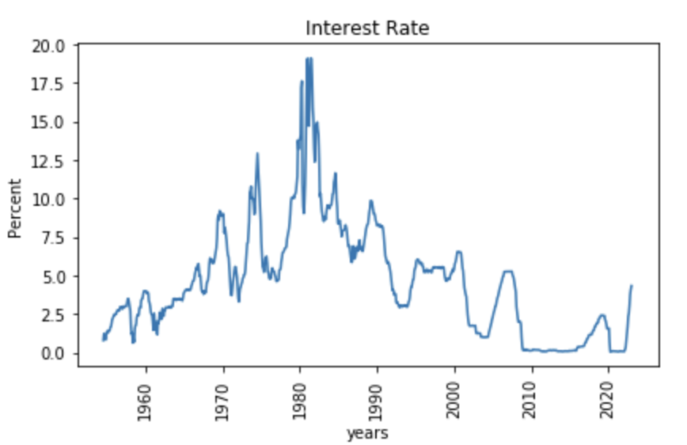
INTEREST RATE

Slide 7
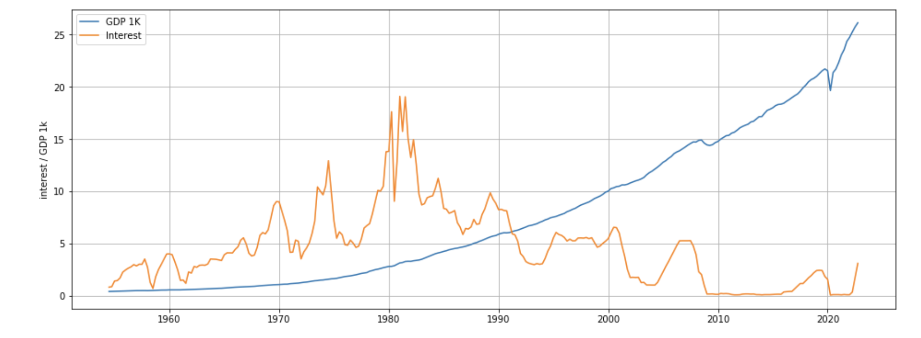
GDP 1k vs interest rates
Avg Annual GDP Growth:
1962 - 1981 = 1%
1982 – 2021 = 8%
Avg Interest Rate Growth:
1962 - 1981 = 6.59%
1982 – 2021 = 4.01%

Slide 8
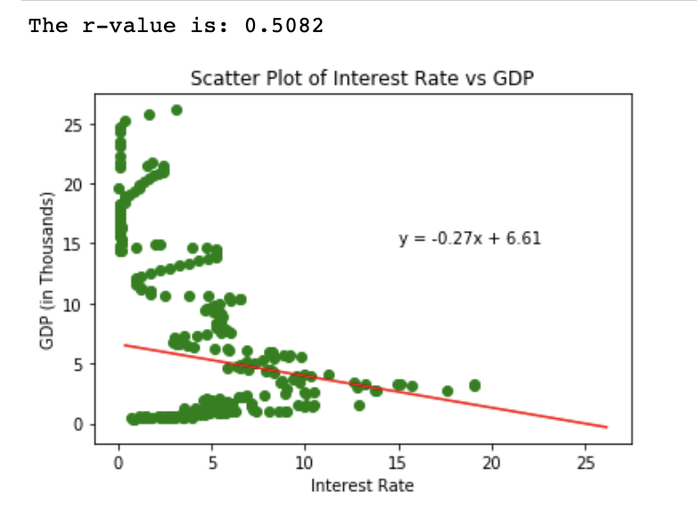
GDP 1k vs interest rates

Slide 9
INFLATION
Consumer Price Index – The average cost for a market basket of goods paid by consumer in urban areas
Market Basket – An imaginary basket of goods and services commonly purchased by consumers (Food, housing, clothing, medical etc.)
Inflation Rate – The increase in the CPI over a set period (typically YoY)

Slide 10
Economic forces, both intentional and unforeseen, are constantly impacting the US economy.
In the US, the inflation rate is one metric used to determine the health of the economy.
A higher inflation rate means that consumers are generally spending more on goods and services.
A lower inflation rate means that consumers are generally spending less on goods and services.
In times of high inflation, the Fed will raise the interest rate to curb inflation.

Slide 11
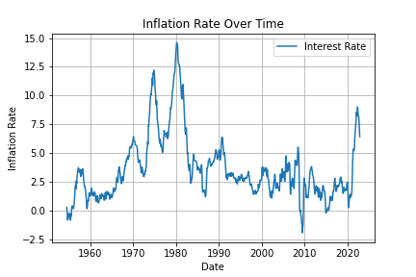
Inflation Rate Over Time
Sample size - 822
July 1, 1954 – December 1, 2022
Min: -1.95%
Max: 14.5%
Ave: 3.5%

Slide 12
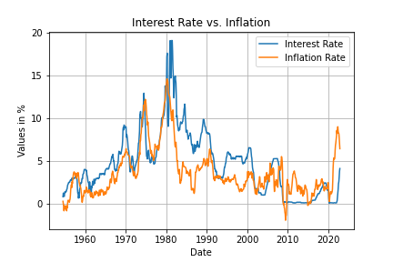
Interest Rate vs Inflation RATE
High interest rate appears to help lower inflation
The highest interest rate and inflation was in the 1980’s

Slide 13
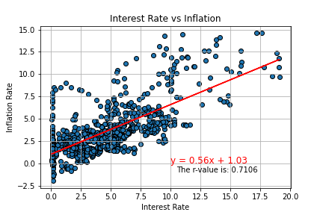
Interest Rate vs Inflation Rate
The r-value is 0.710.
This represents a strong correlation between inflation and interest rates.
This strong correlation suggests that raising the interest rate by the fed is a working solution to combat rising inflation.

Slide 14
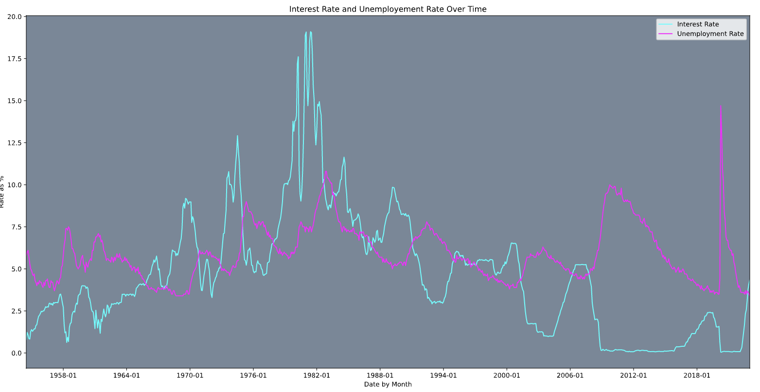
INTEREST RATE AND UNEMPLOYMENT RATE OVER TIME

Slide 15
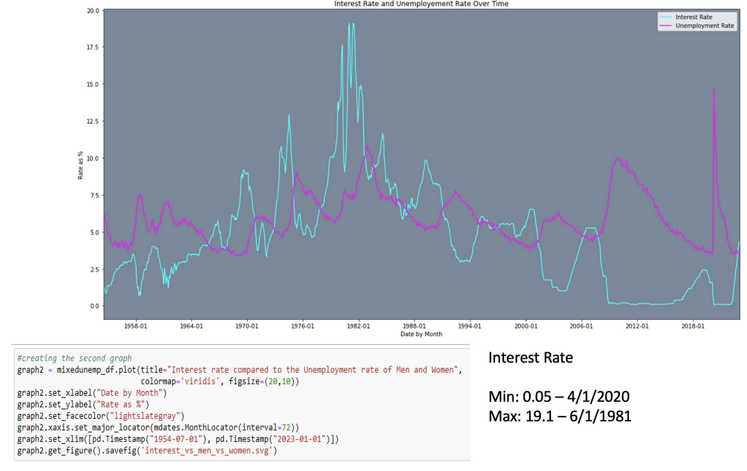
INTEREST RATE AND UMEMPLOYMENT RATE OVER TIME

Slide 16
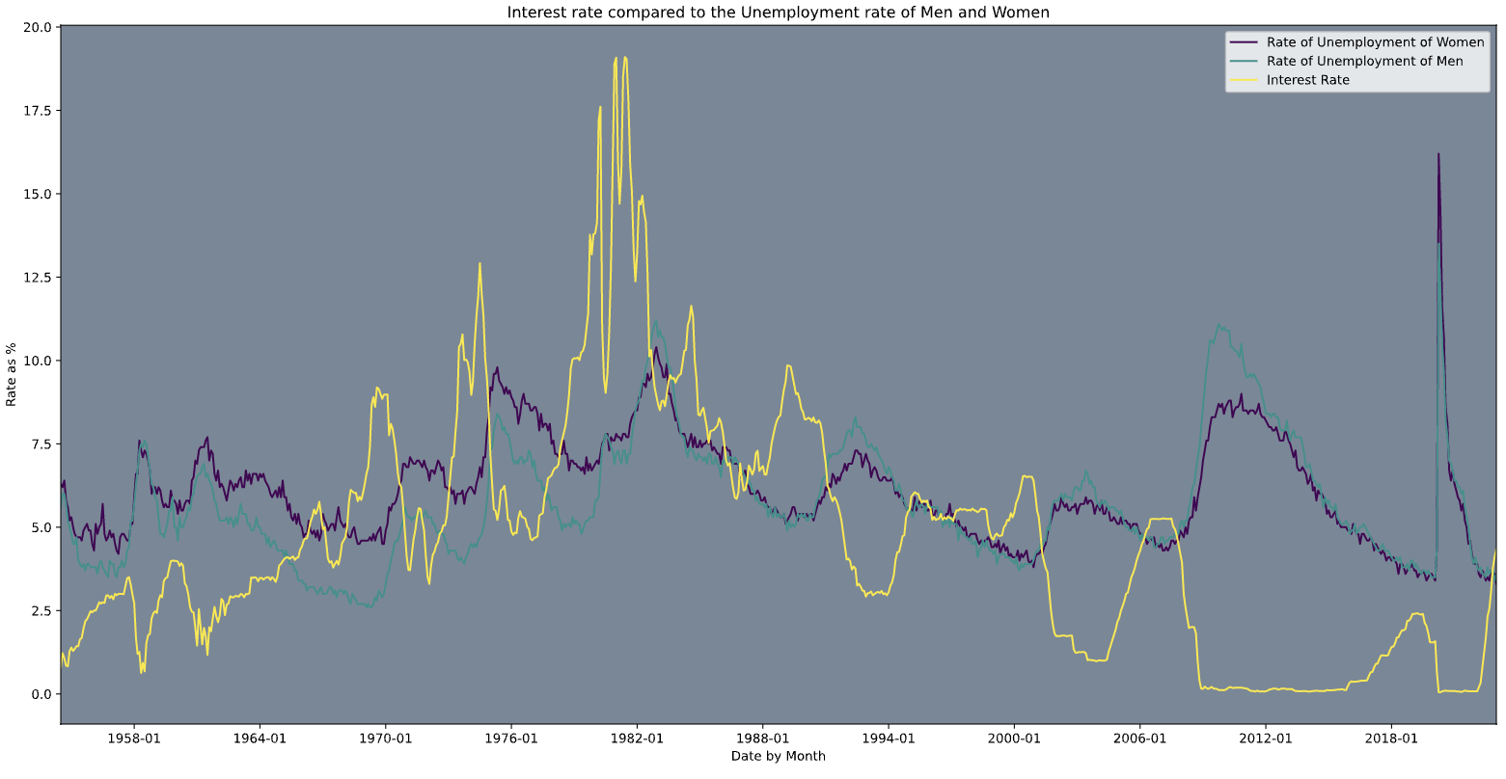
INTEREST RATE COMPARED TO THE UNEMPLOYMENT RATE OF MEN AND WOMEN

Slide 17
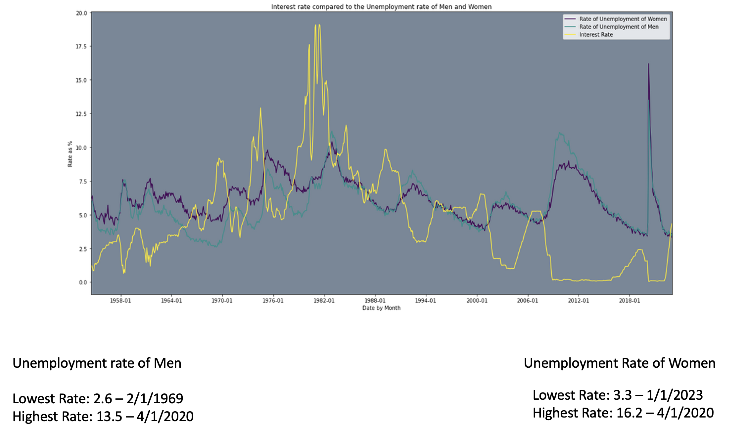
INTEREST RATE COMPARED TO THE UNEMPLOYMENT RATE OF MEN AND WOMEN

Slide 18
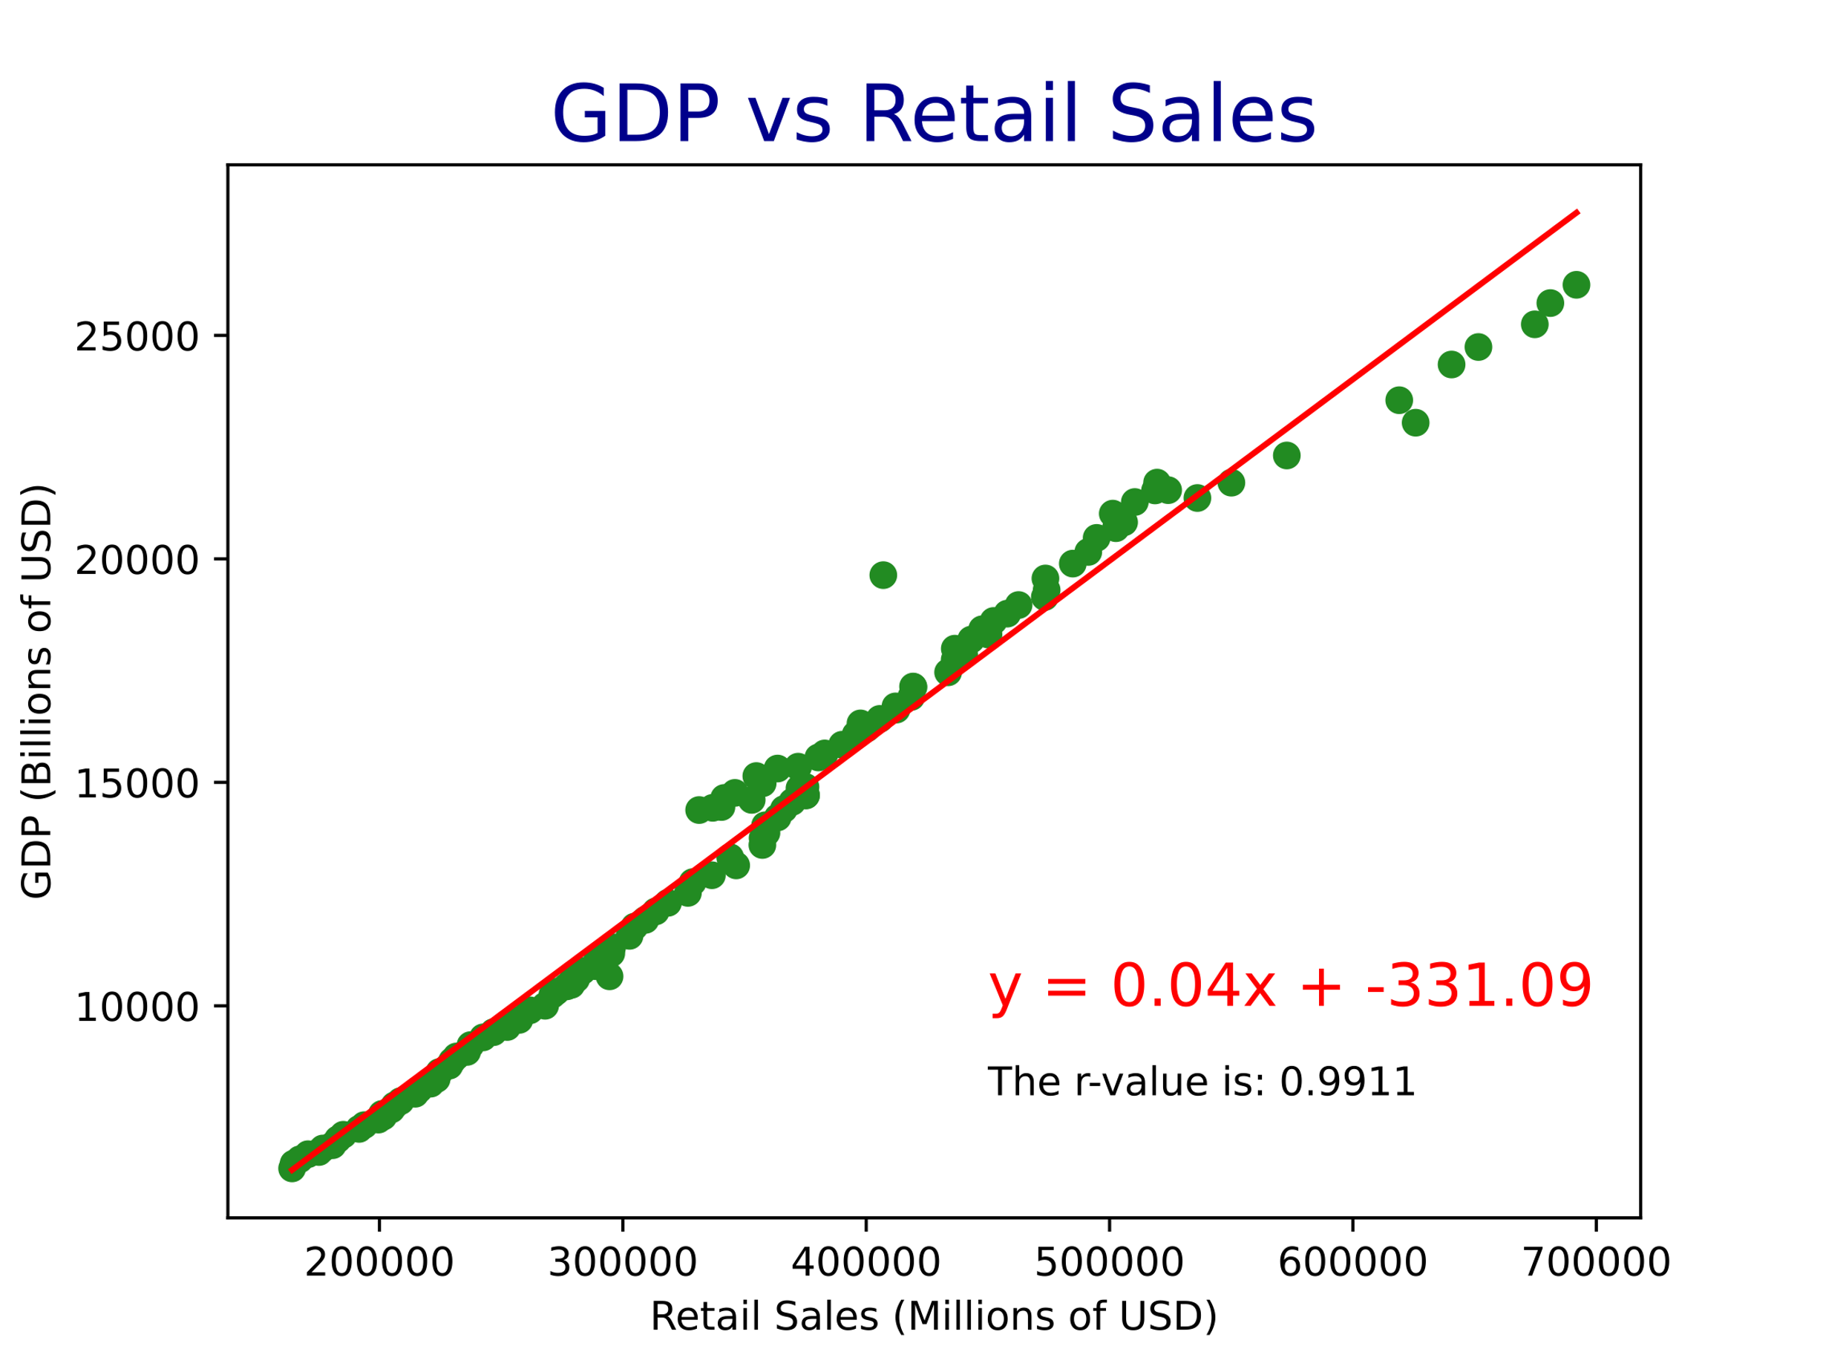
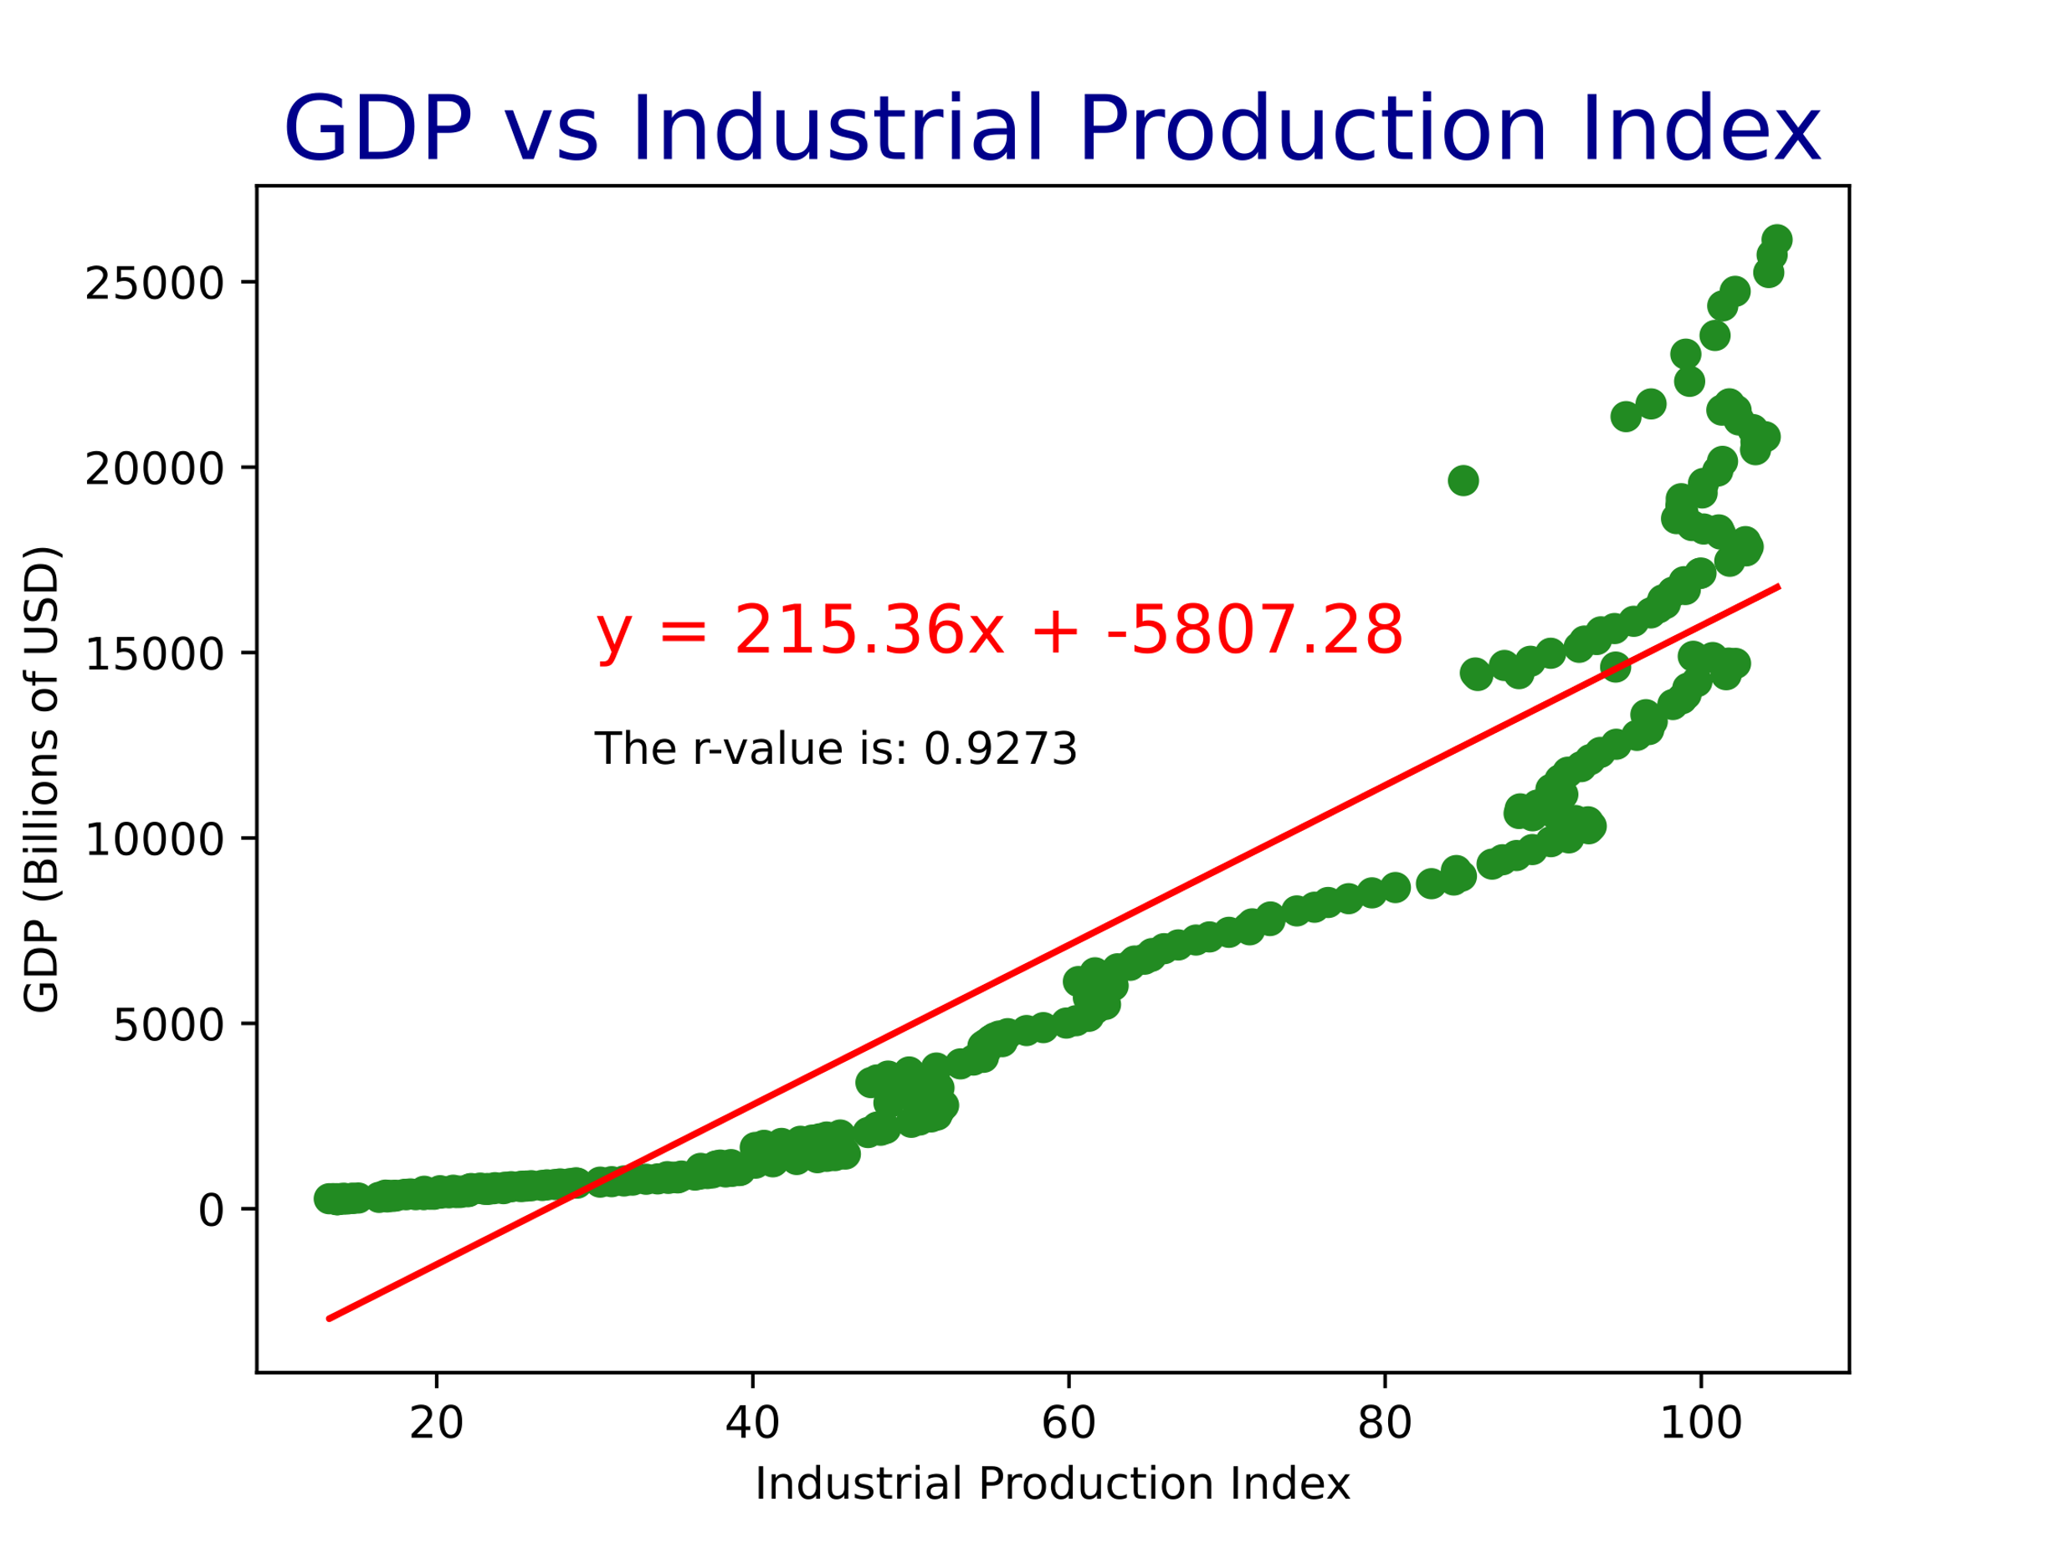
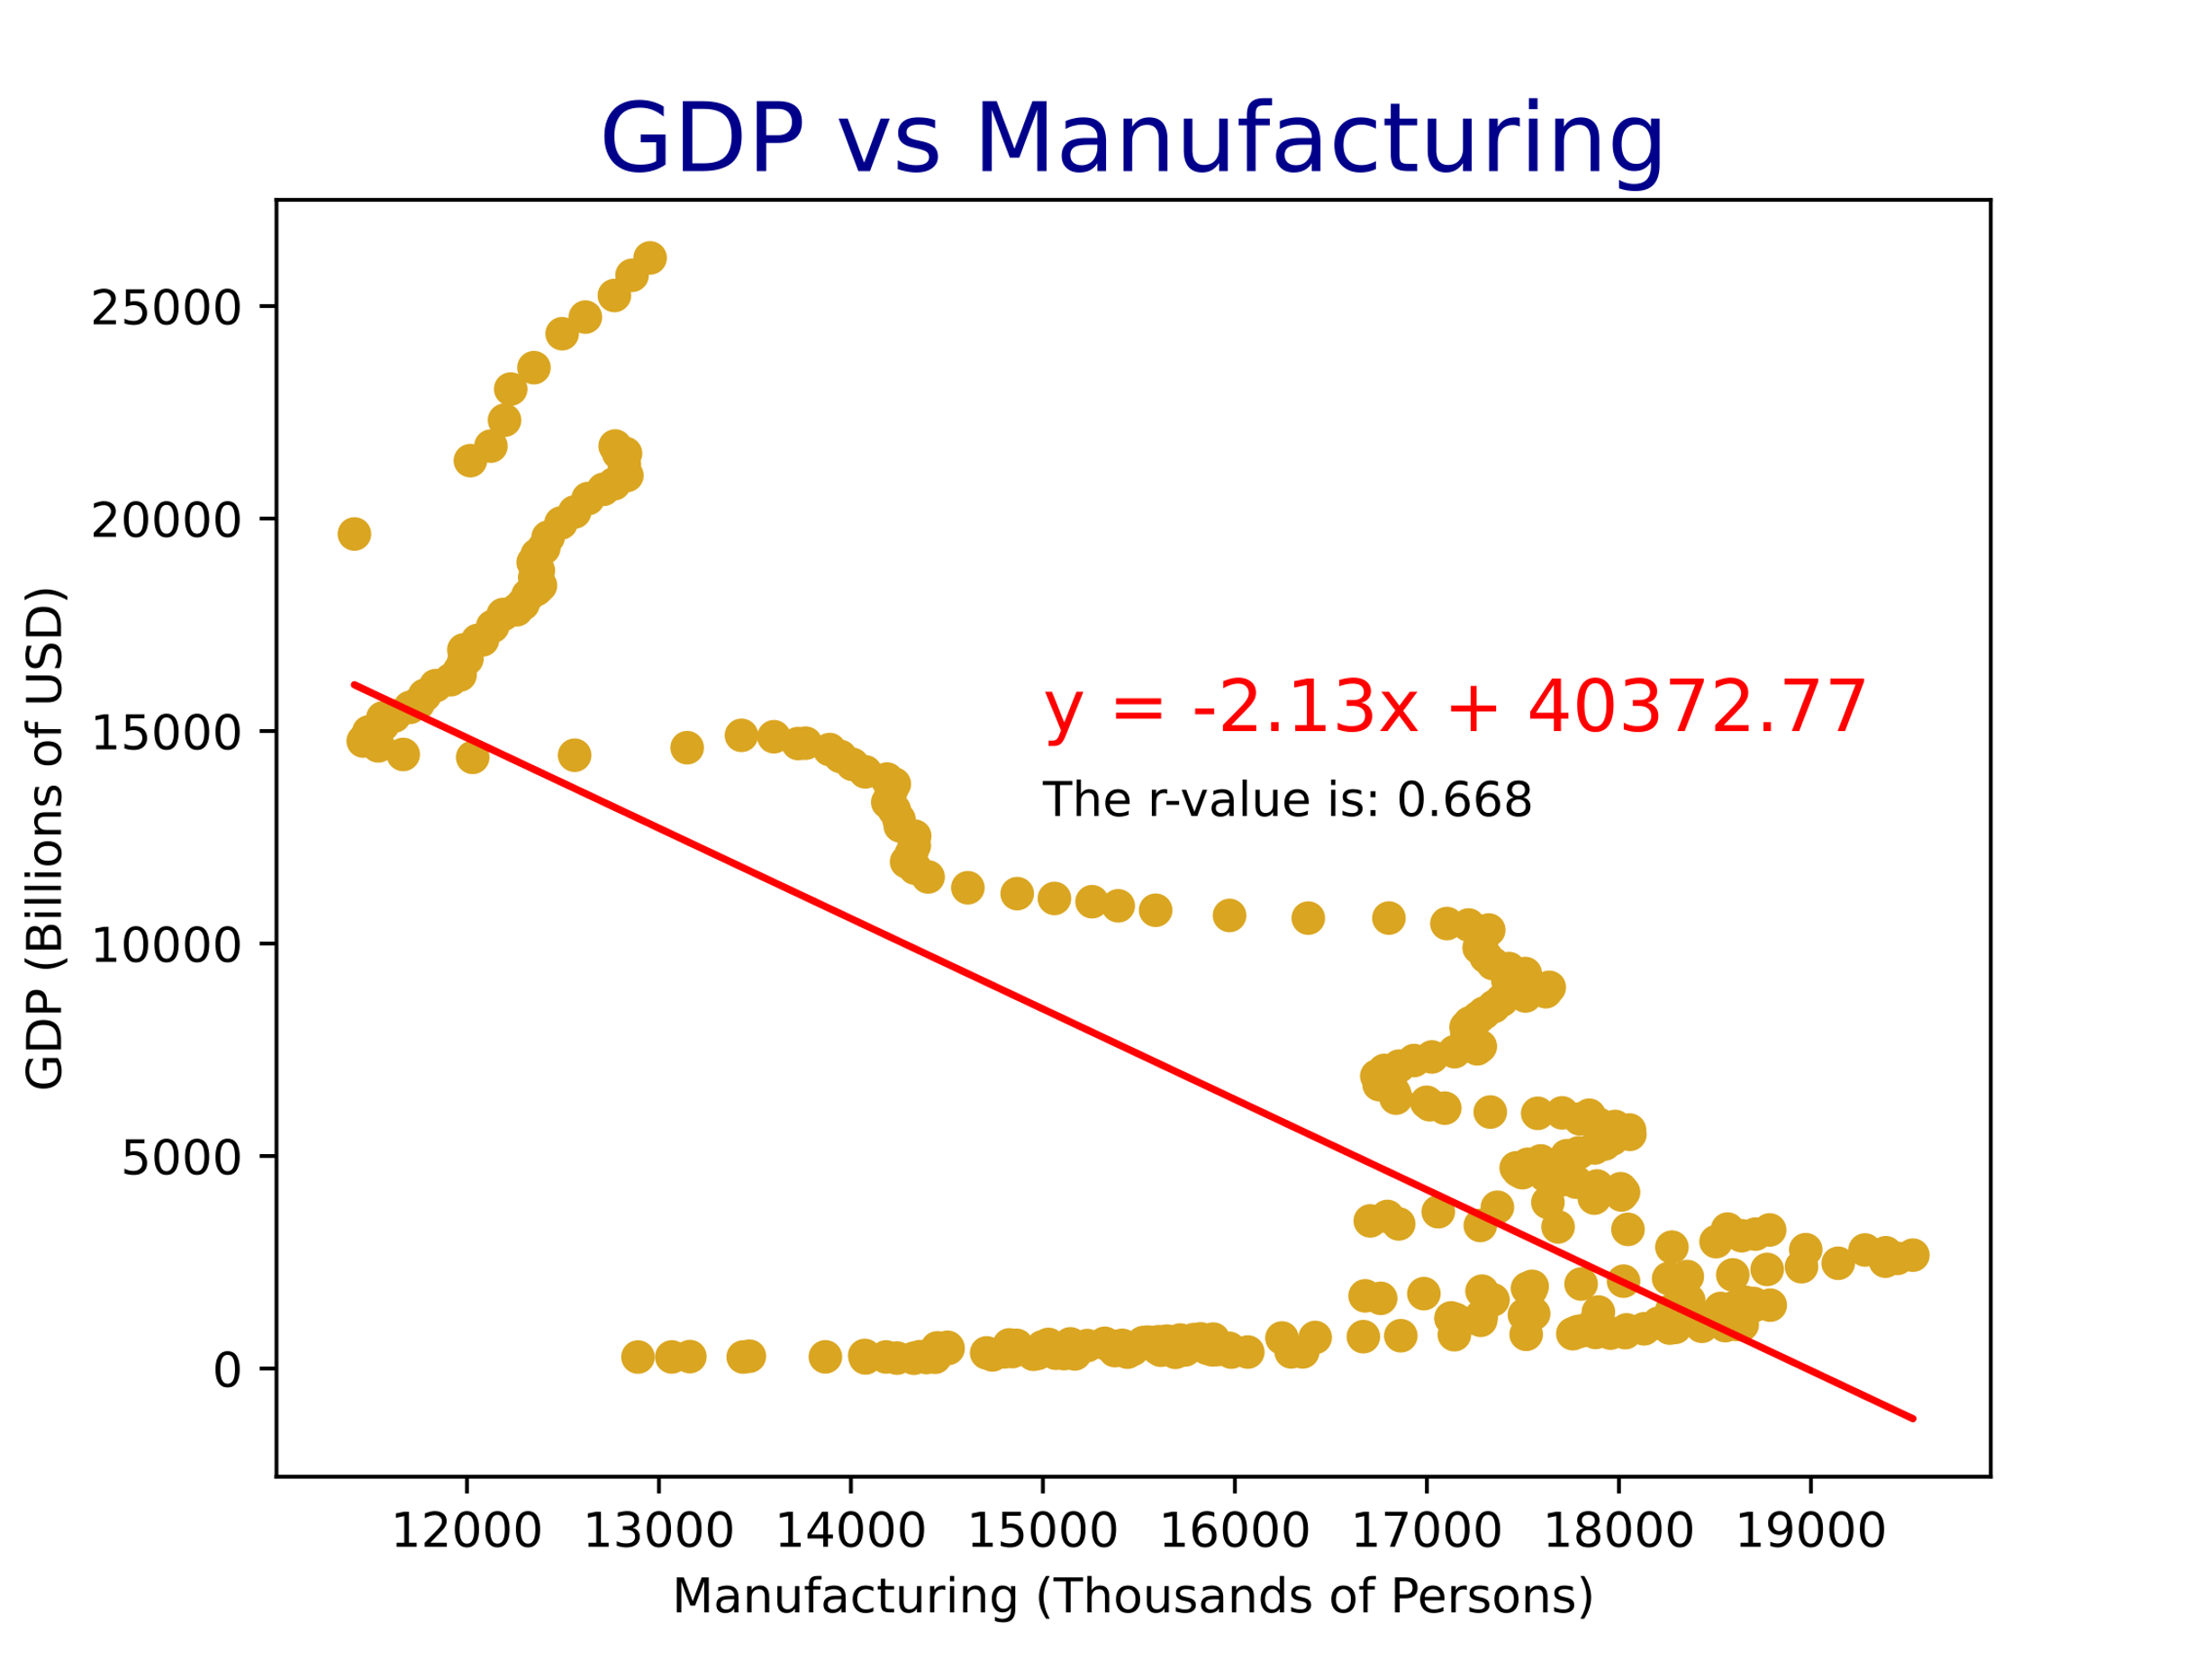
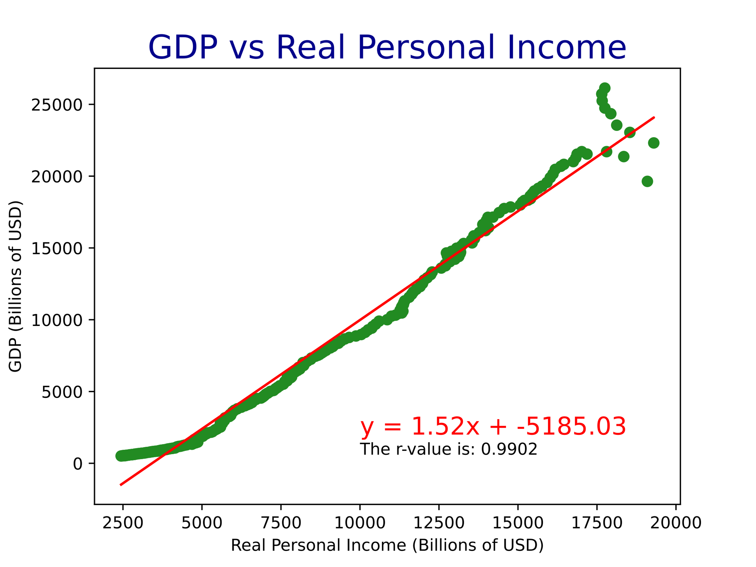
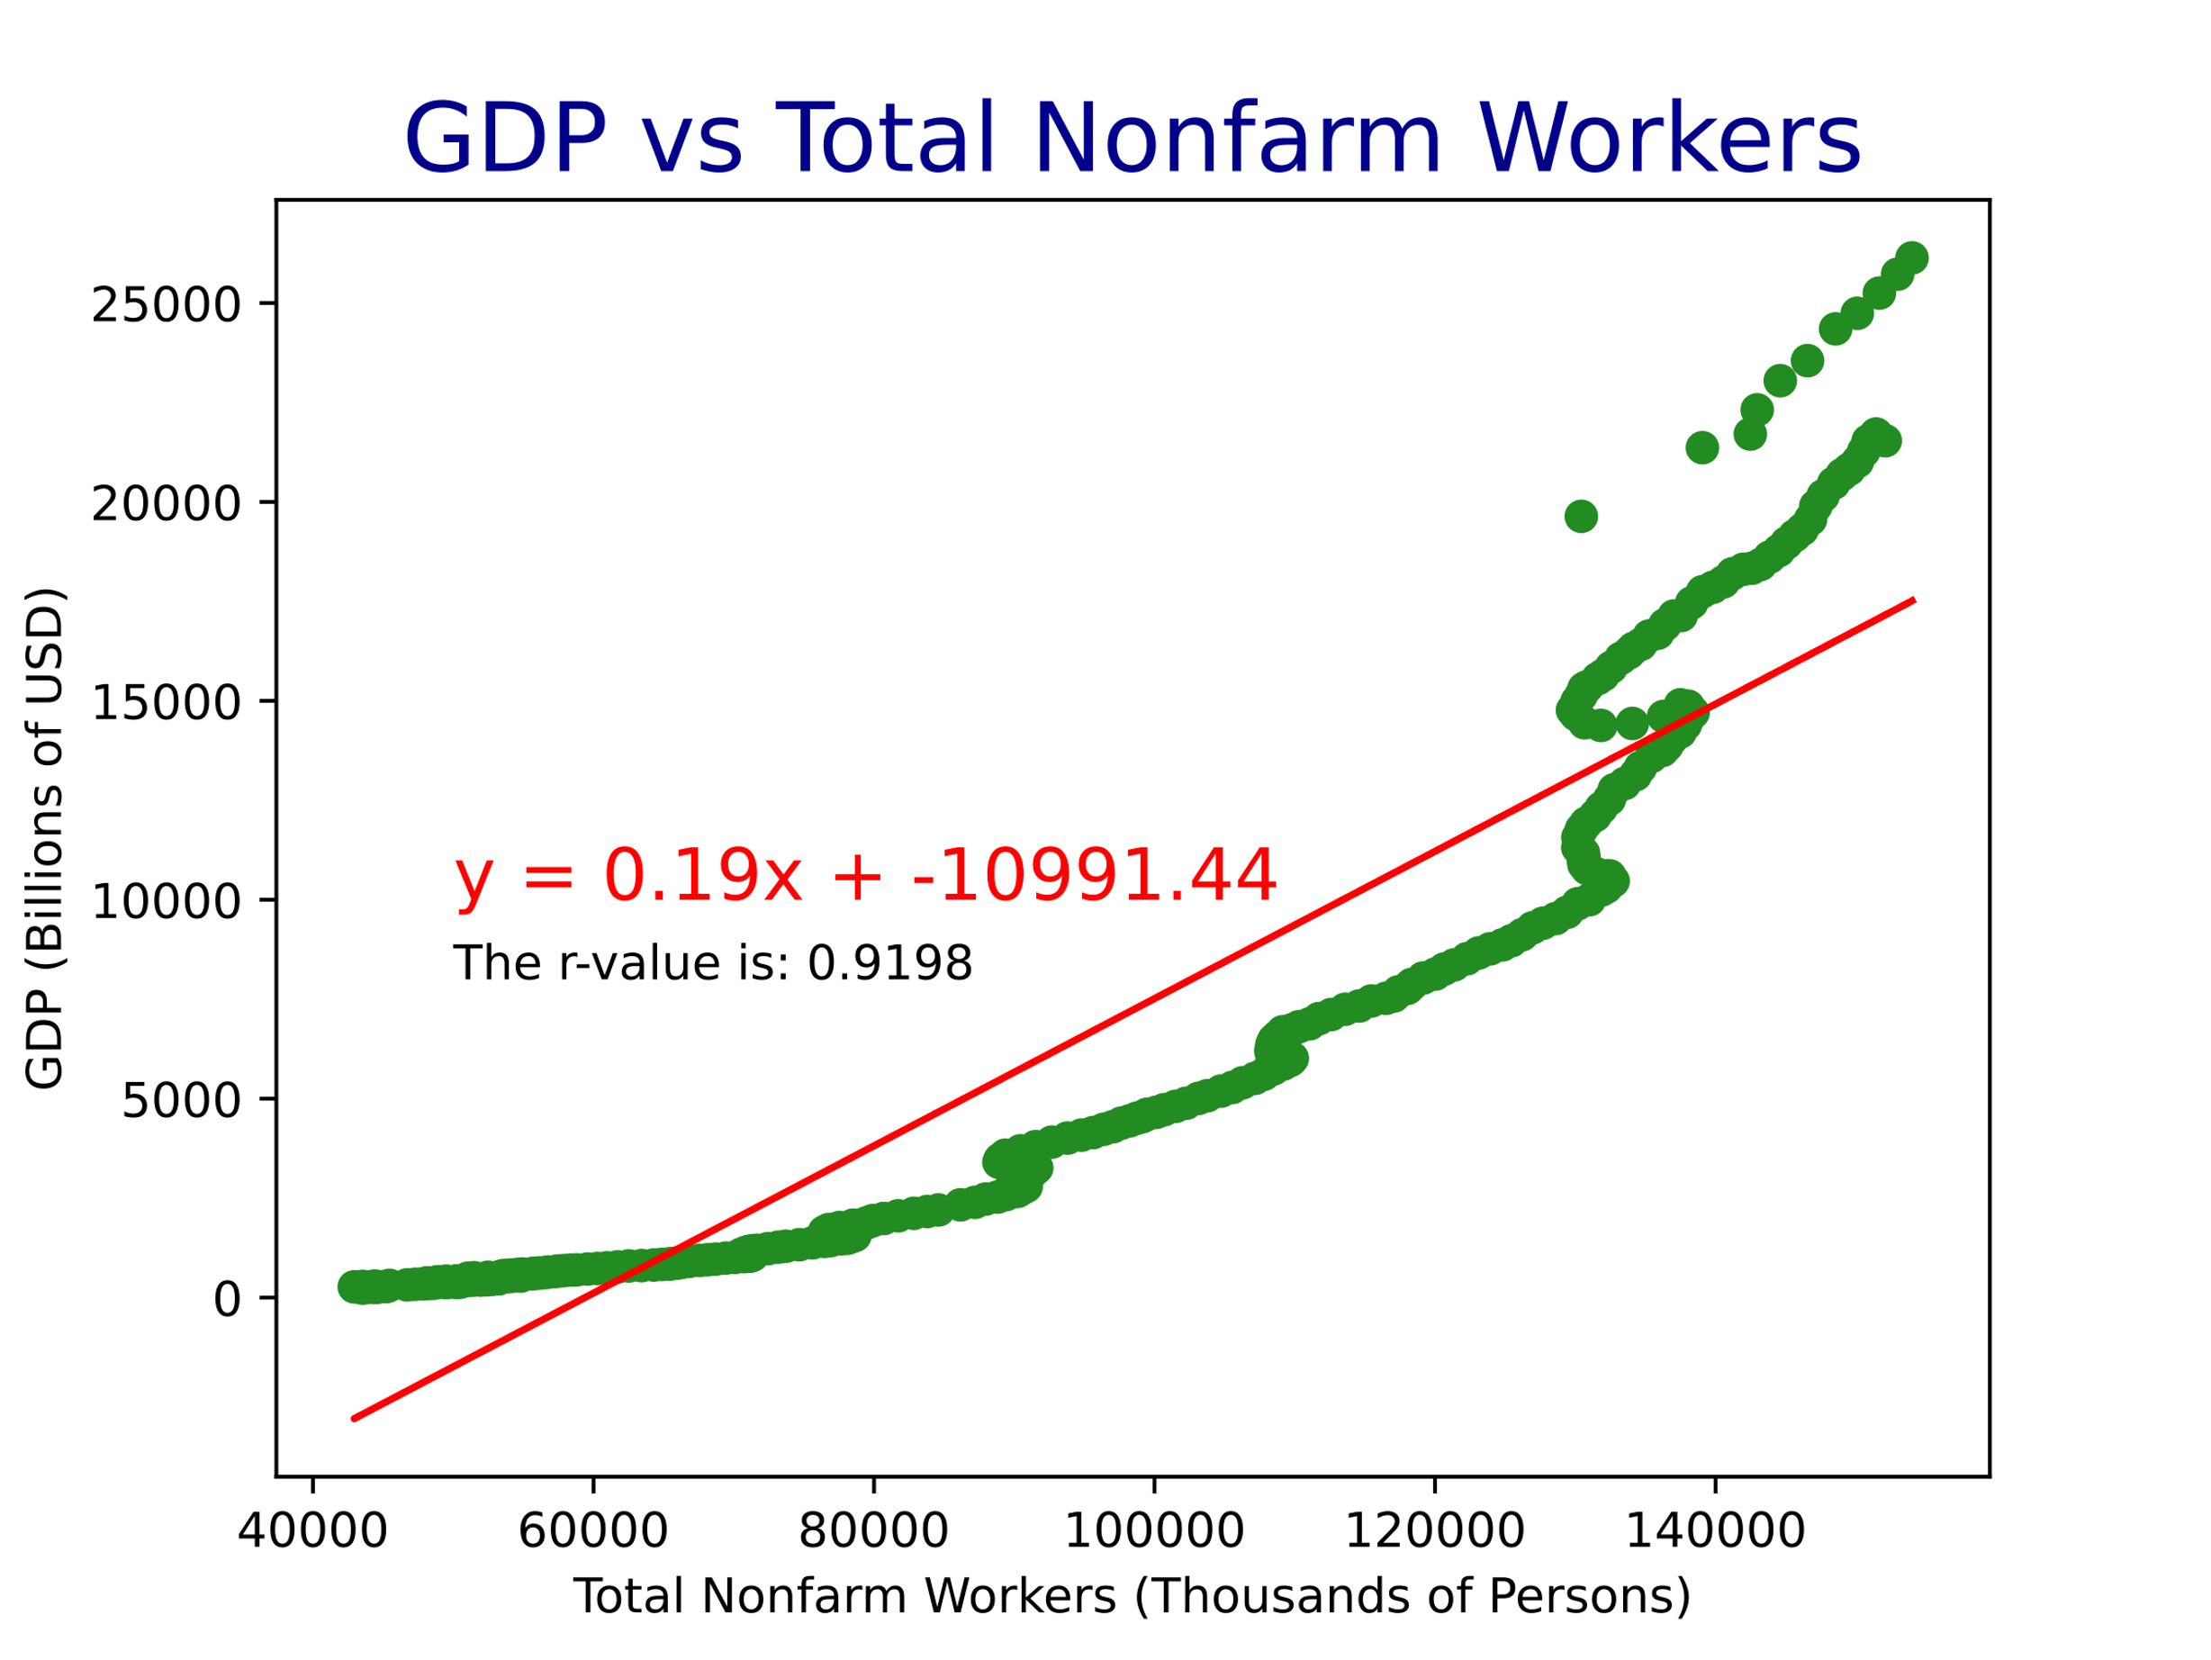
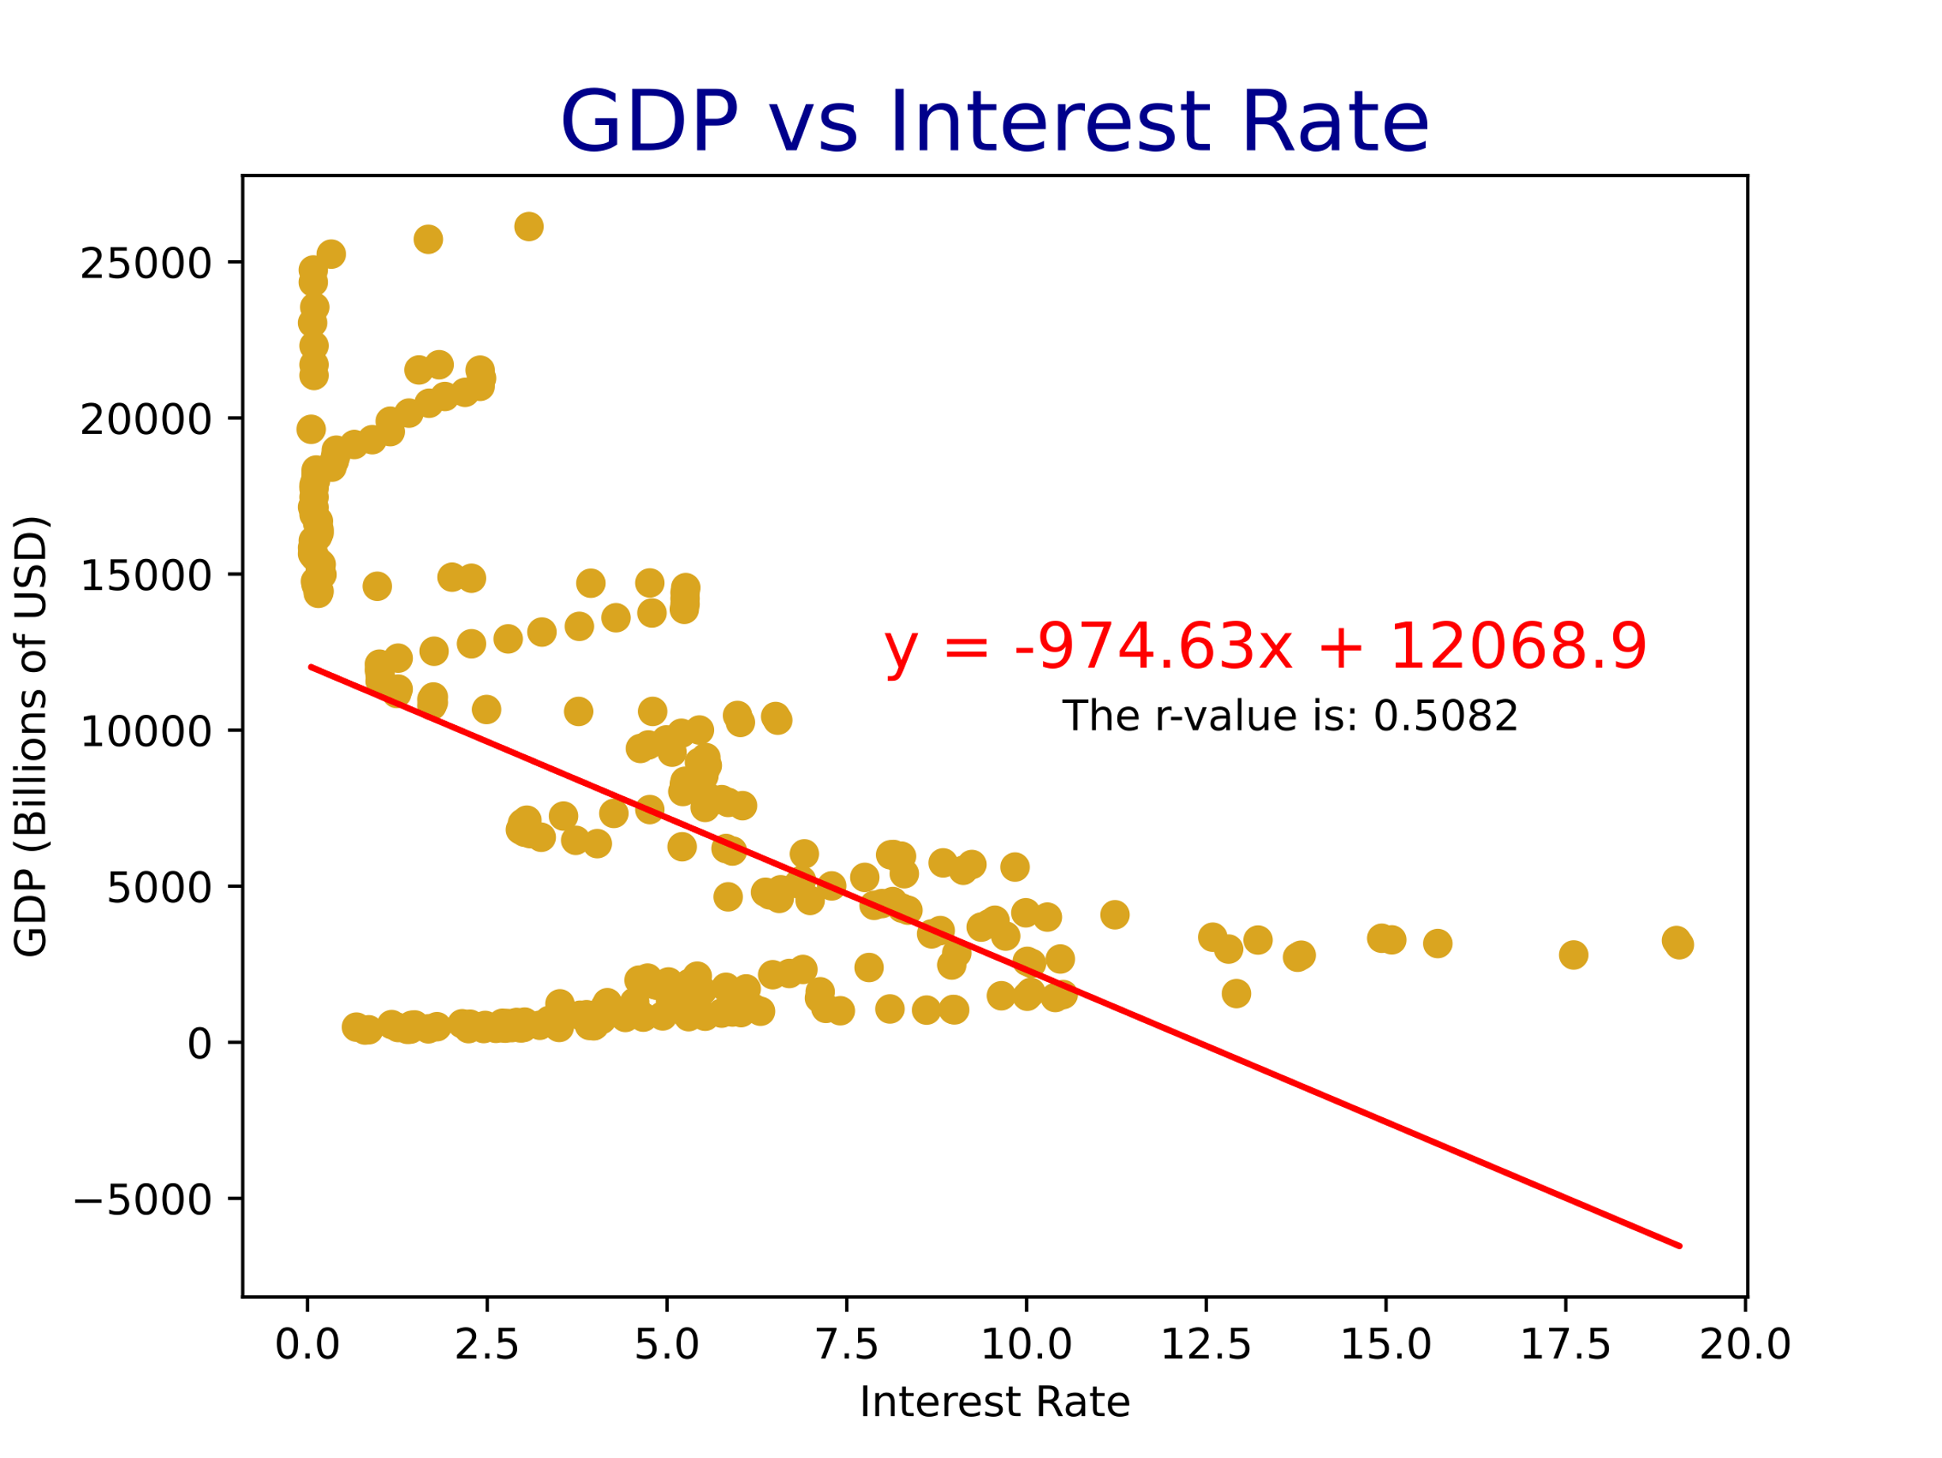
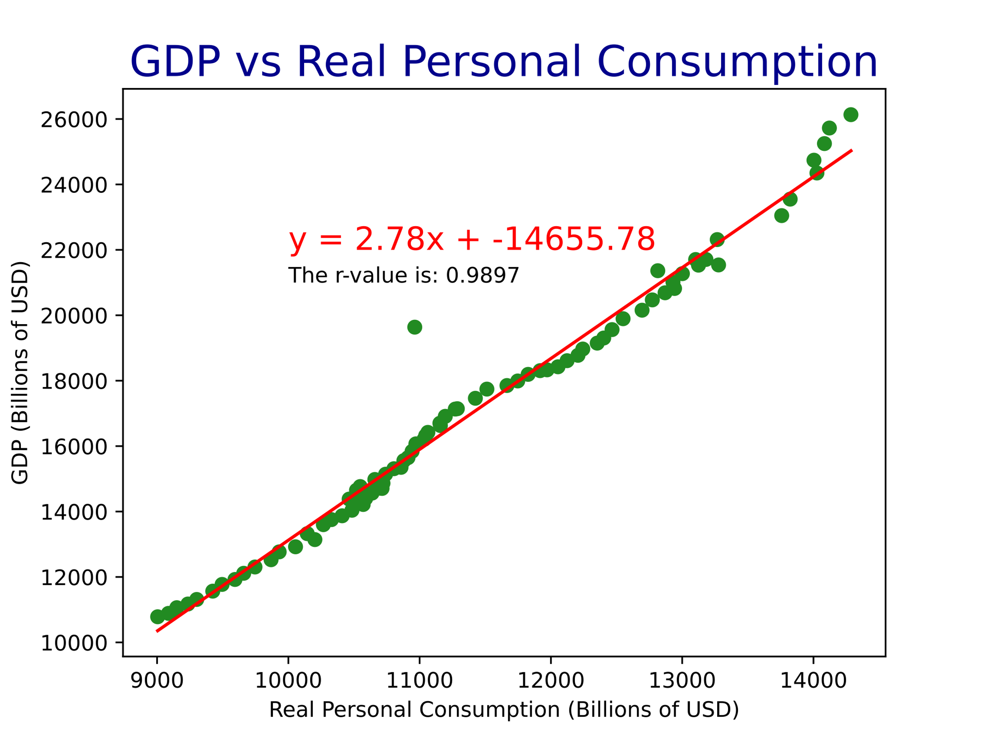
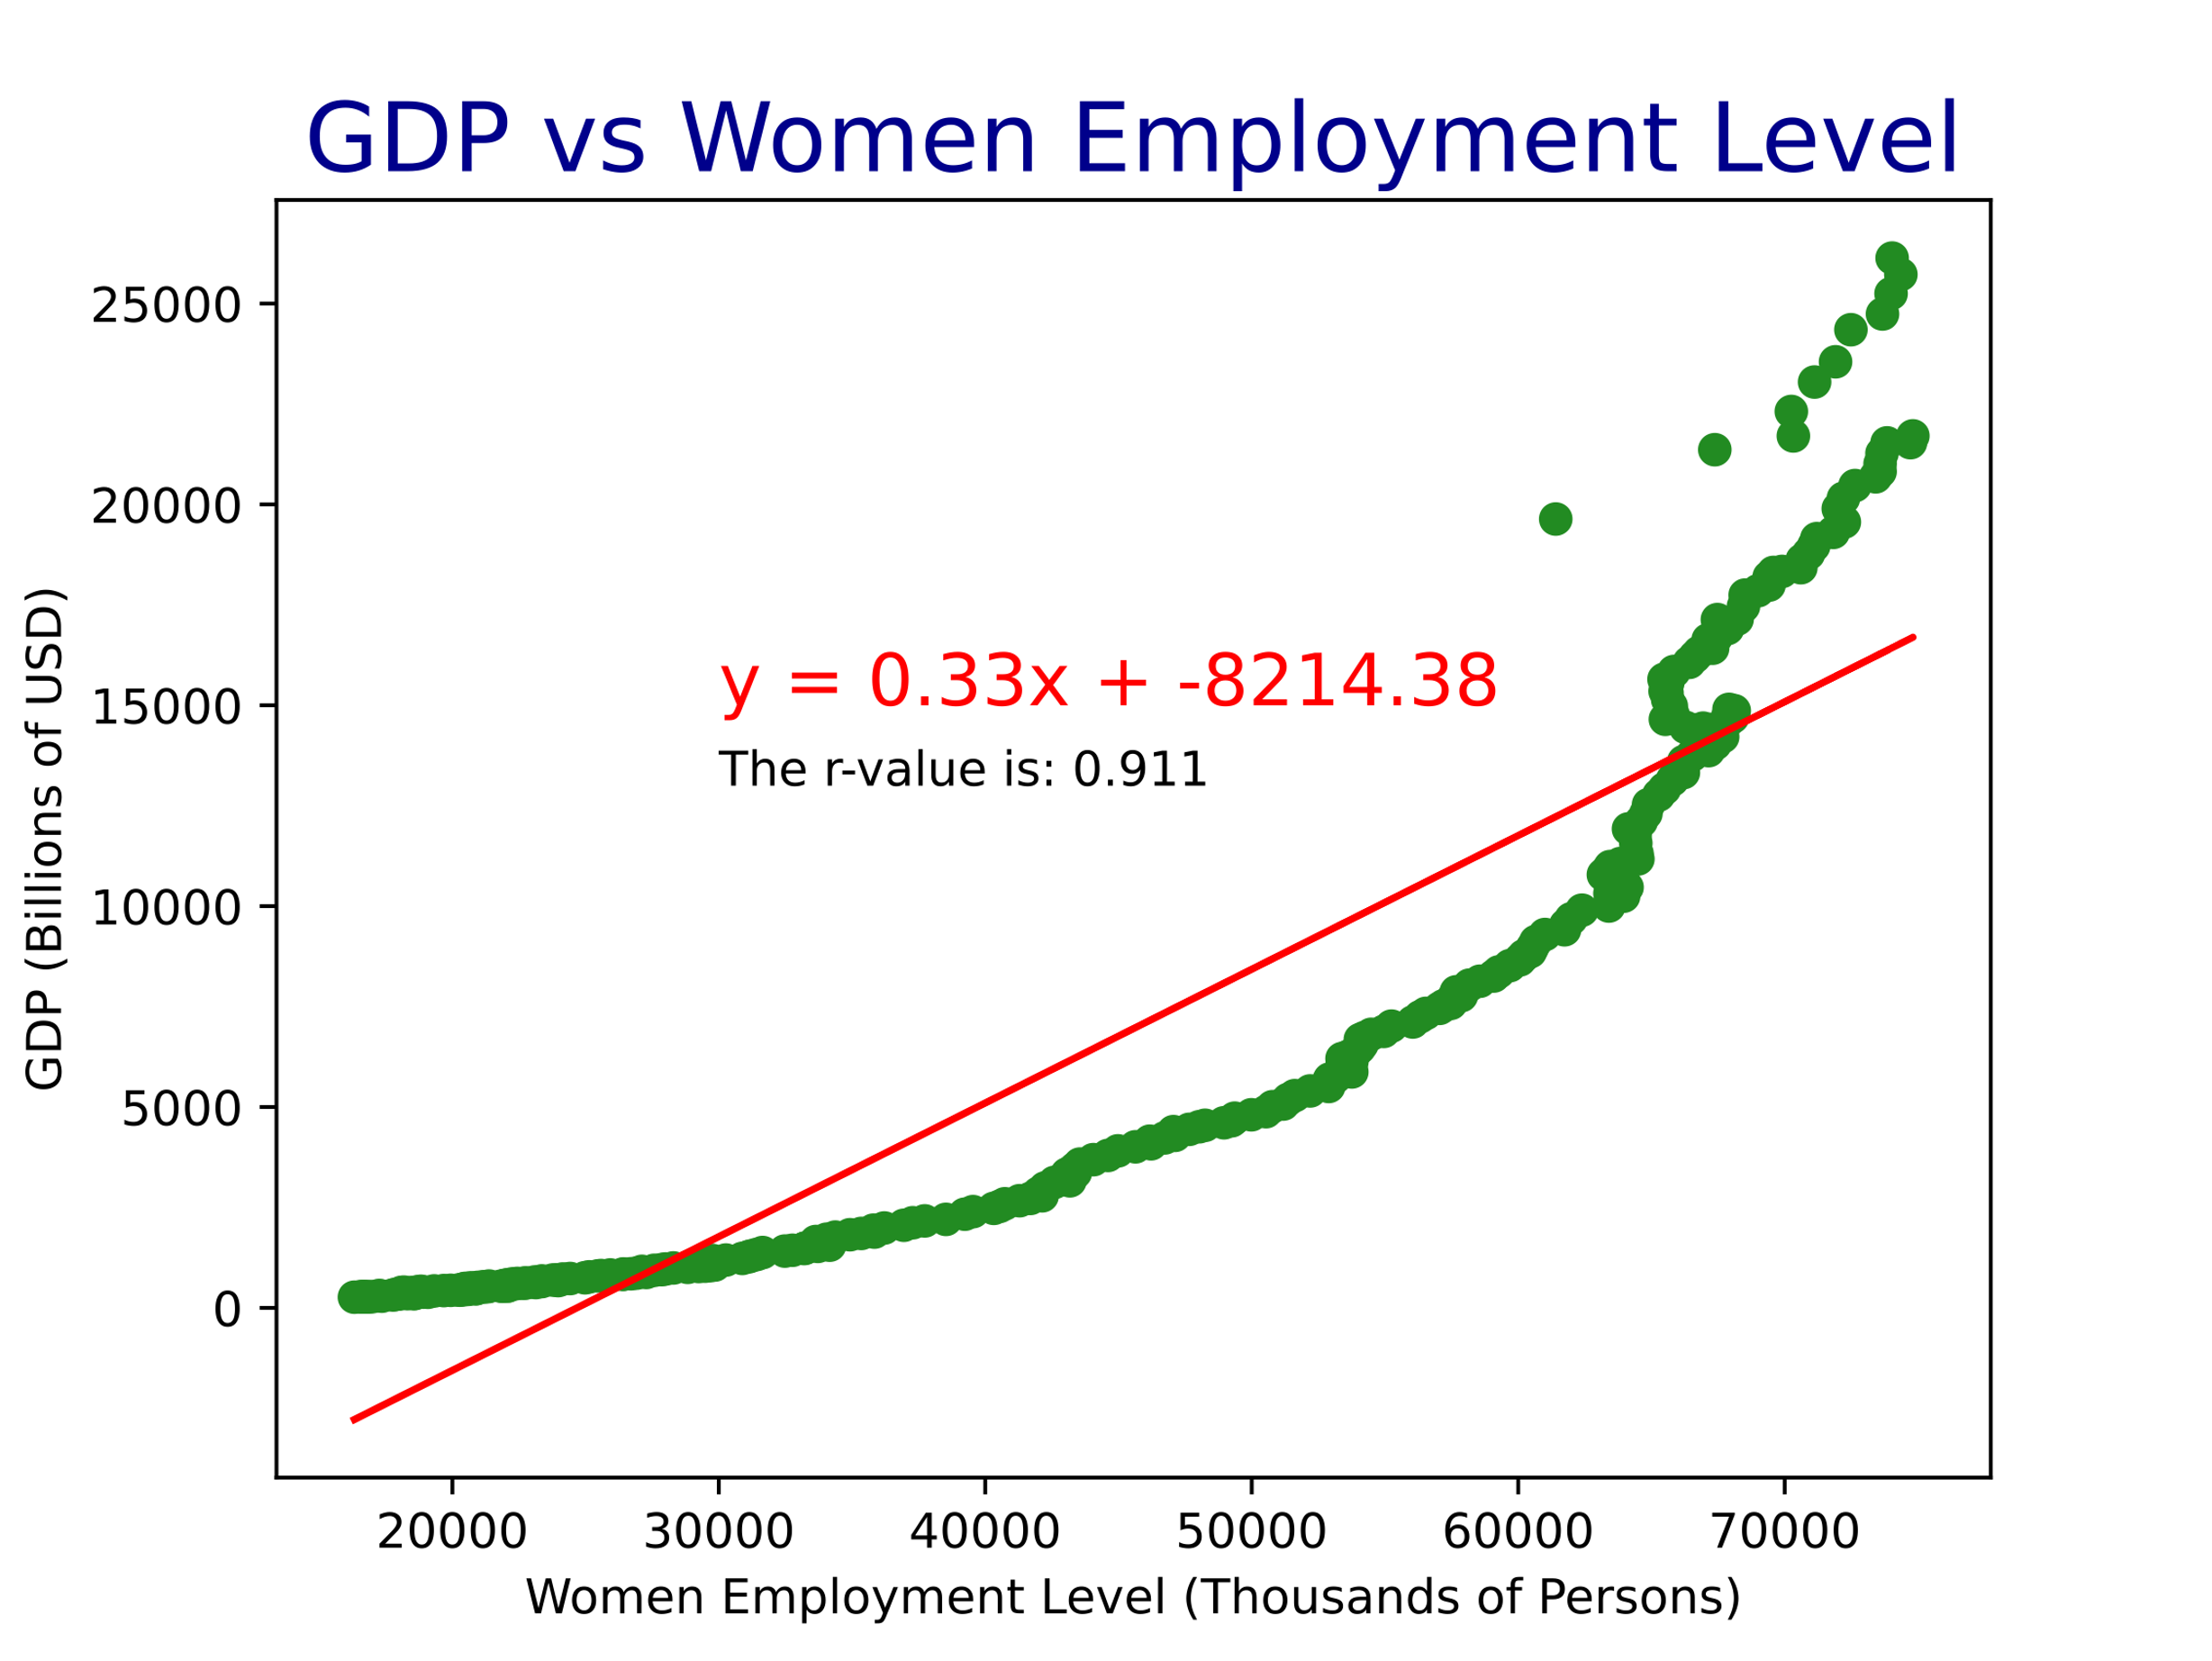
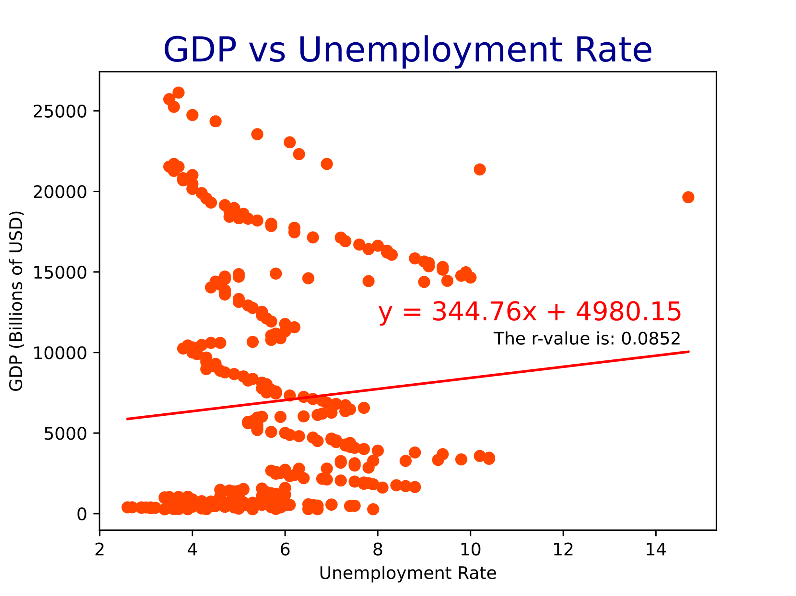

Slide 19
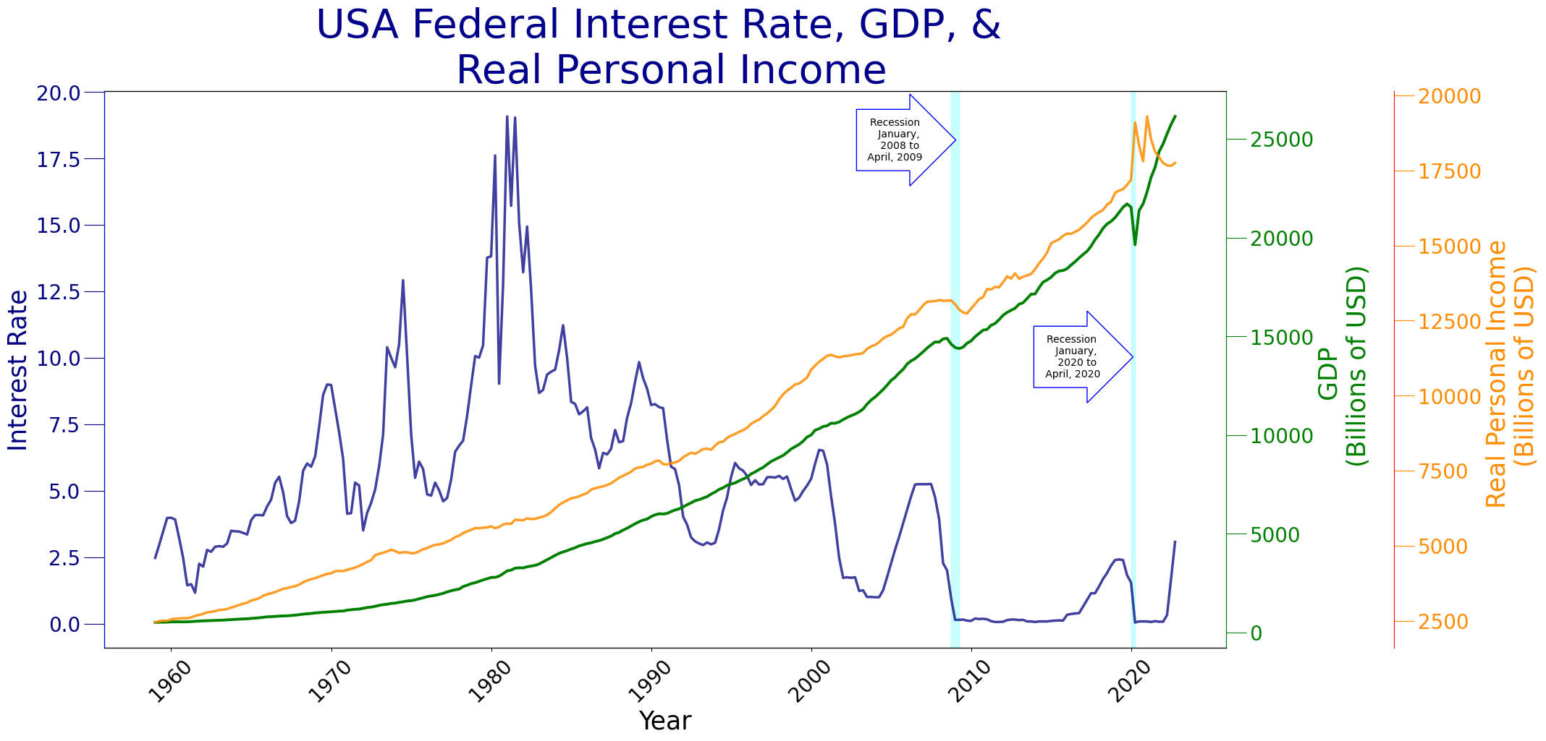

Slide 20
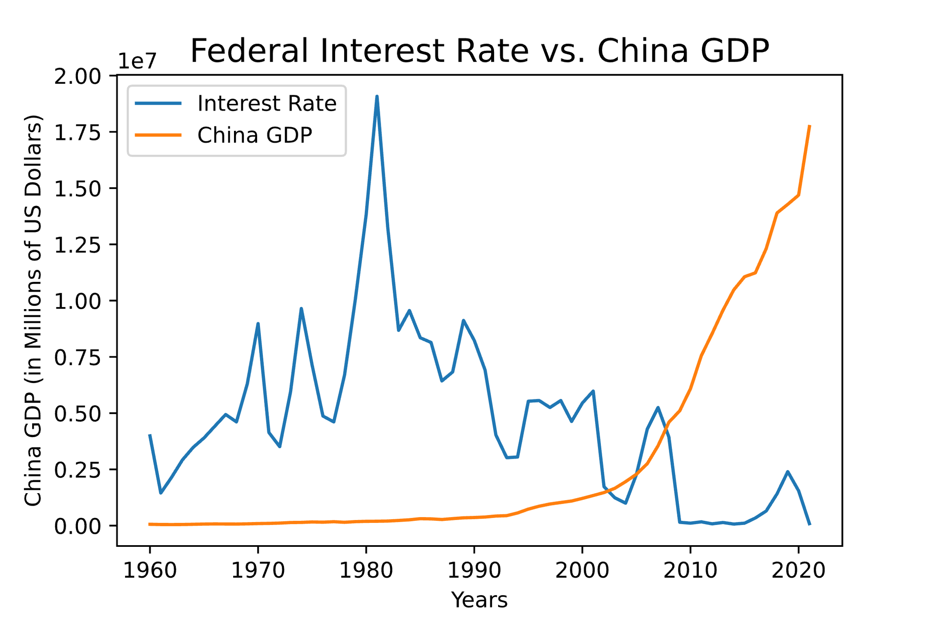
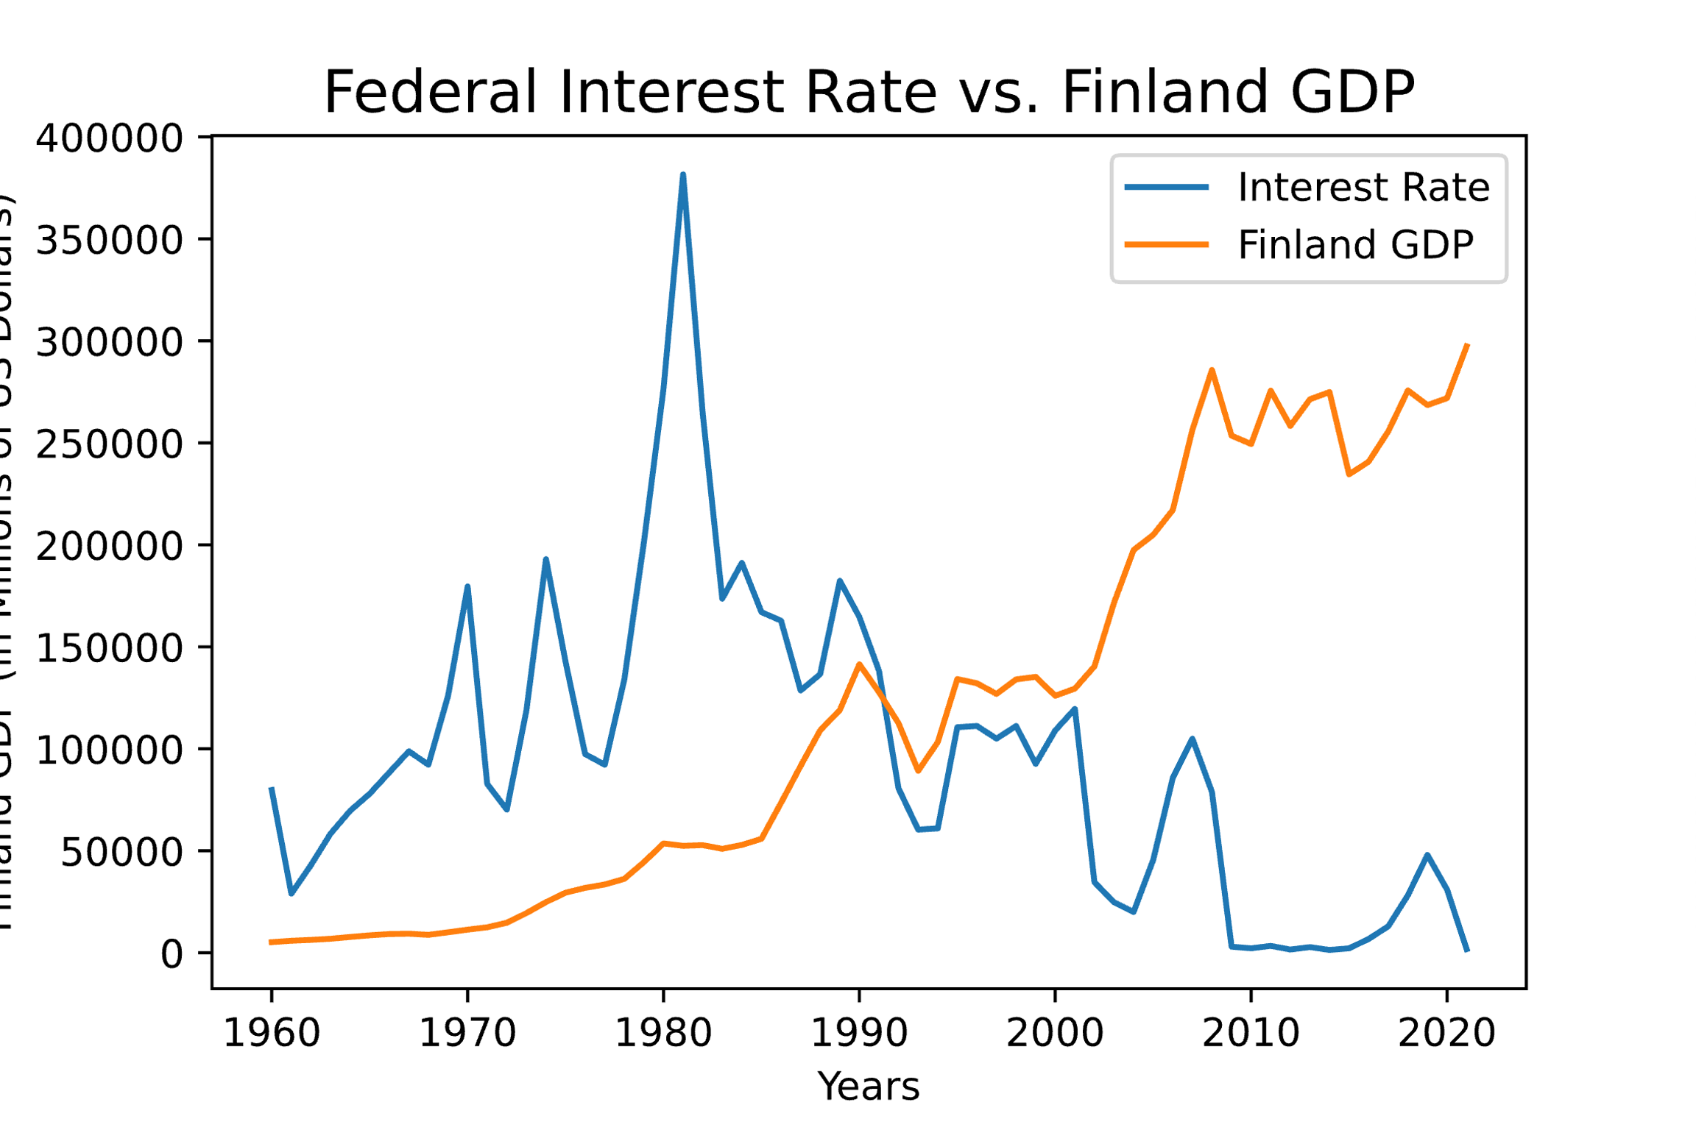
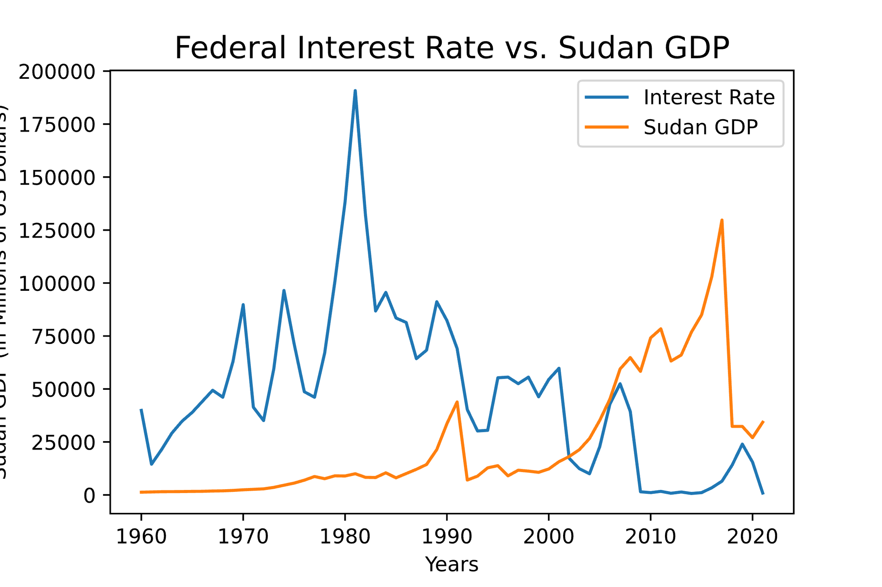
Global impact of federal interest rate
Economy Similar in Size as US
Bottom of the ‘Top 50 Economies’
Economy of Third World Country

Slide 21
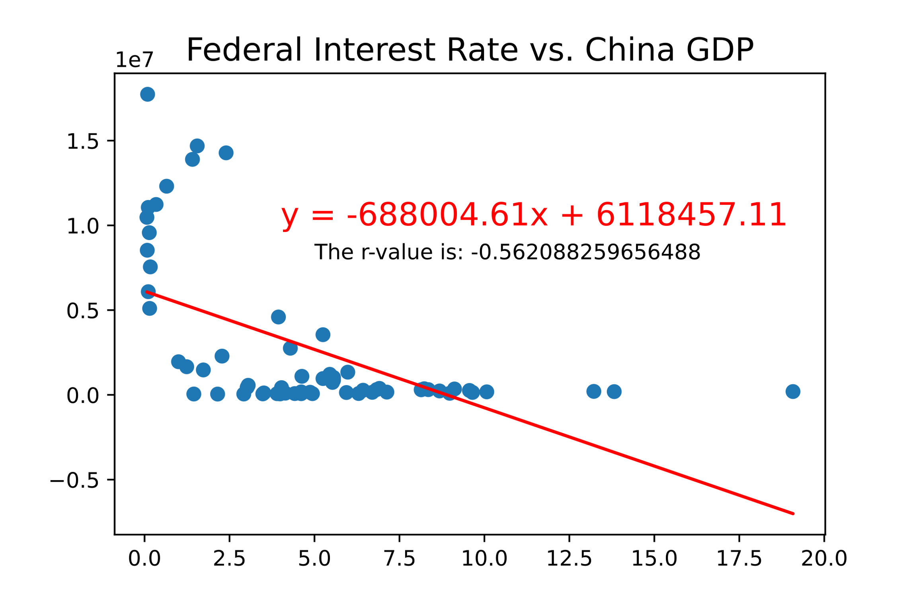
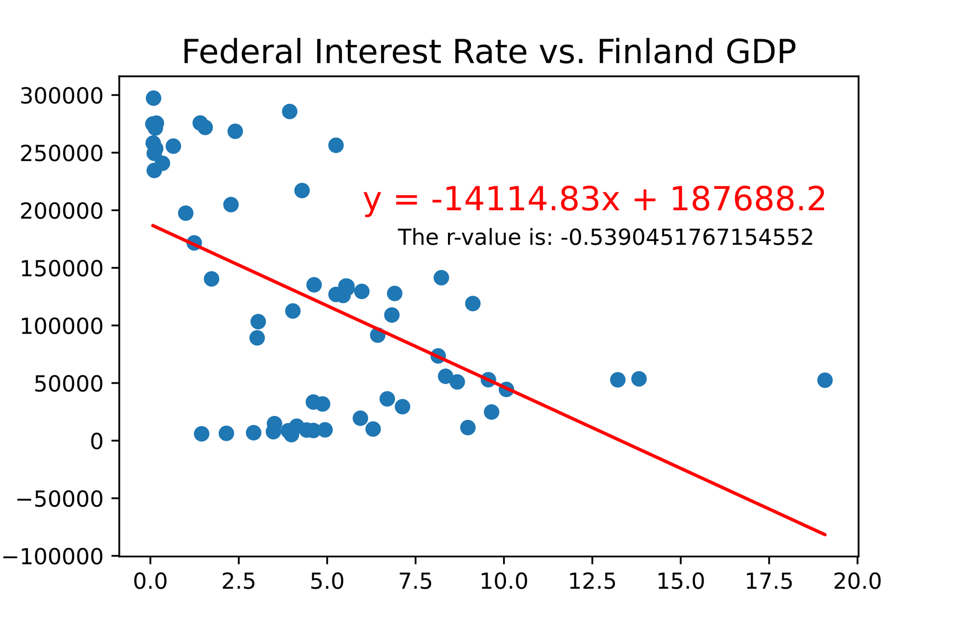
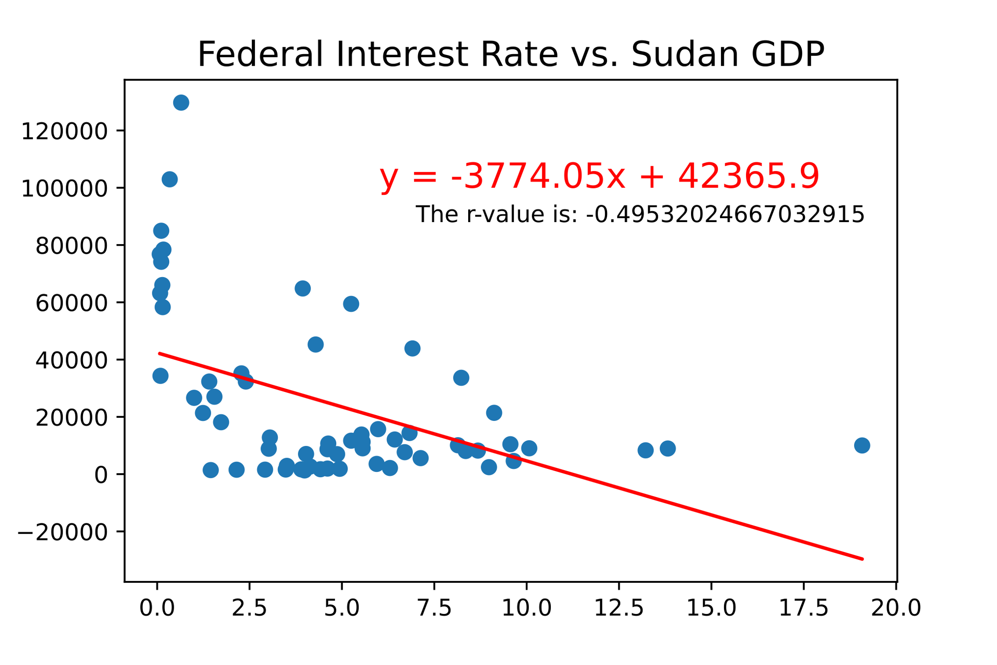
Global impact of federal interest rate
Moderate Negative Correlation
Moderate Negative Correlation
Weak Negative Correlation

Slide 22
Conclusion
The strong correlation between interest rates and inflation suggests that raising the interest rate is a working solution to combat rising inflation.
Interest rate and unemployment rates are related, but rising interest rates don't necessitate low unemployment rates.
There is a weak to moderate linear relationship between GDP and interest rates. Higher interest rates can slow down the economy.
Rises and falls of the Federal Interest Rate do not affect the Global Economy.
There is no definitive economic indicator that can predict the next recession.
Retail sales, real personal income, and the industrial production index outperform interest rate in correlation to GDP.

Slide 23

THANK YOU
Armann Andaya
Justin Dean
Michelle Owino
Riley Unverferth
Kenan White

